Slide 1


Lecture 12: Exercises
CS5481 Data Engineering
Instructor: Yifan Zhang

Slide 2
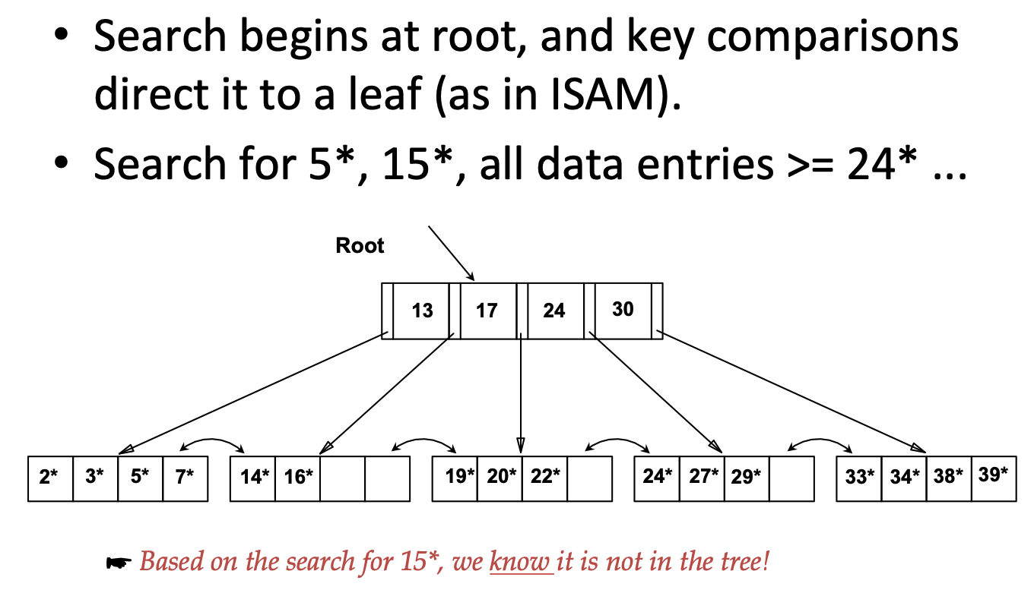
Exercise: B+ Tree

Slide 3
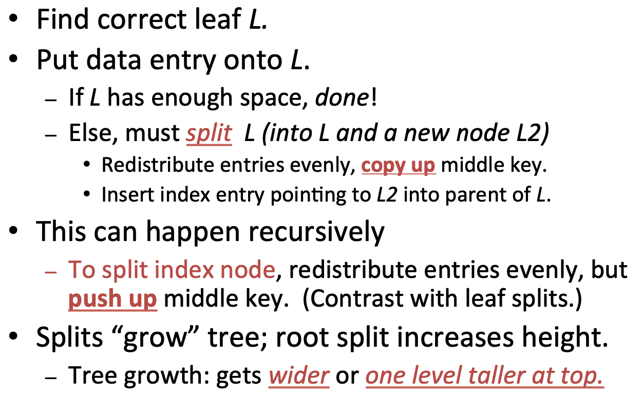
Review: B+ Tree Insertion

Slide 4
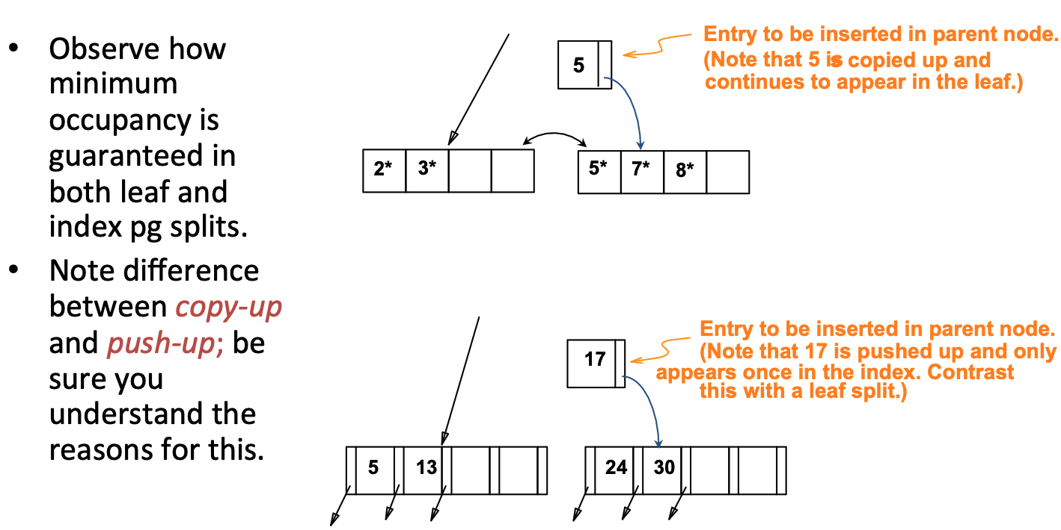
Exercise: Insert 8* into Example B+ Tree

Slide 5
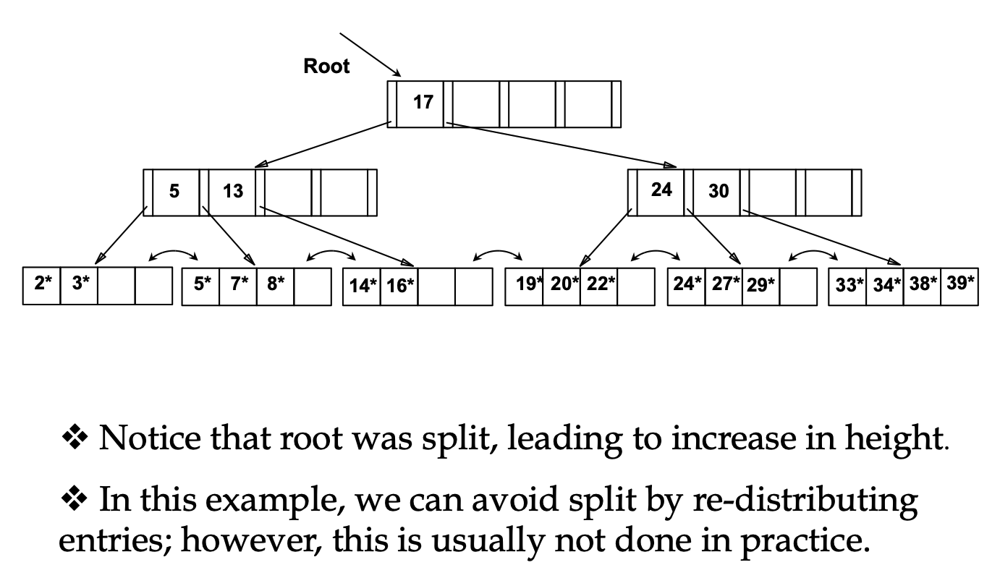
Exercise: Inserting 8* into Example B+ Tree

Slide 6
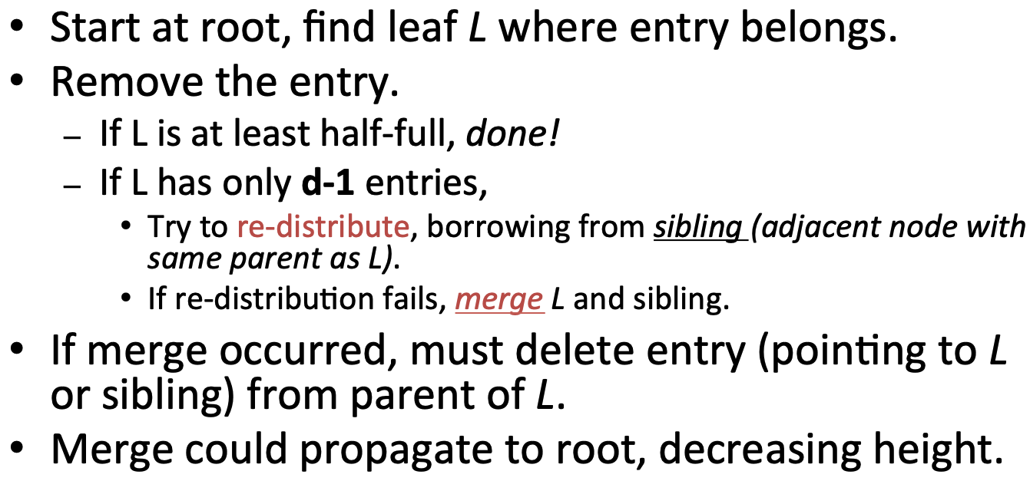
Review: B+ Tree Deletion

Slide 7
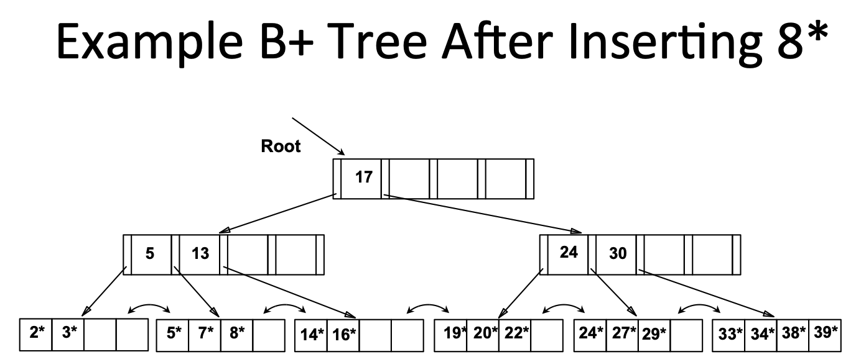
Exercise: Delete 19* and 20* From B+ Tree

Slide 8
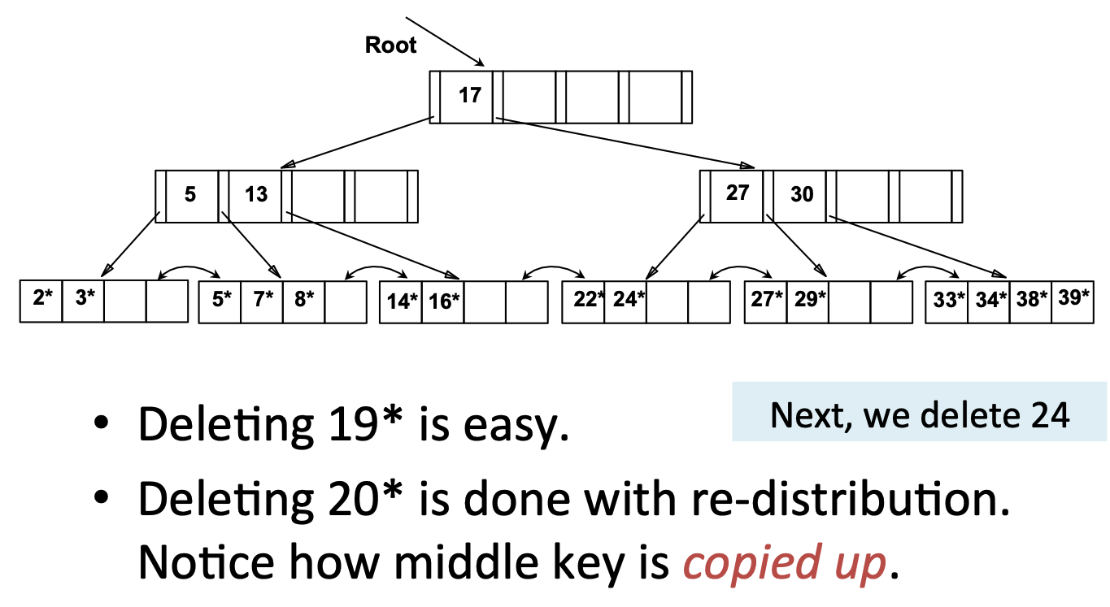
Example Tree After (Inserting 8*, Then) Deleting 19* and 20* ...

Slide 9
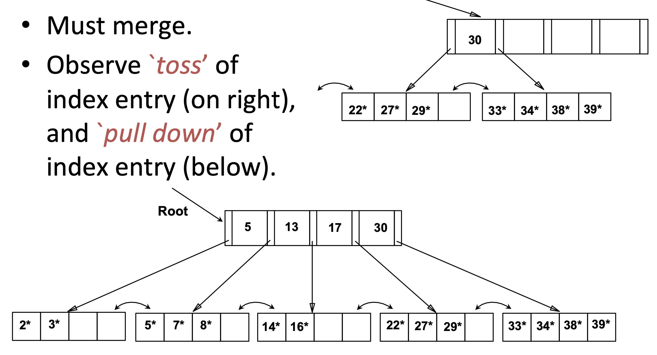
… And Then Deleting 24*

Slide 10
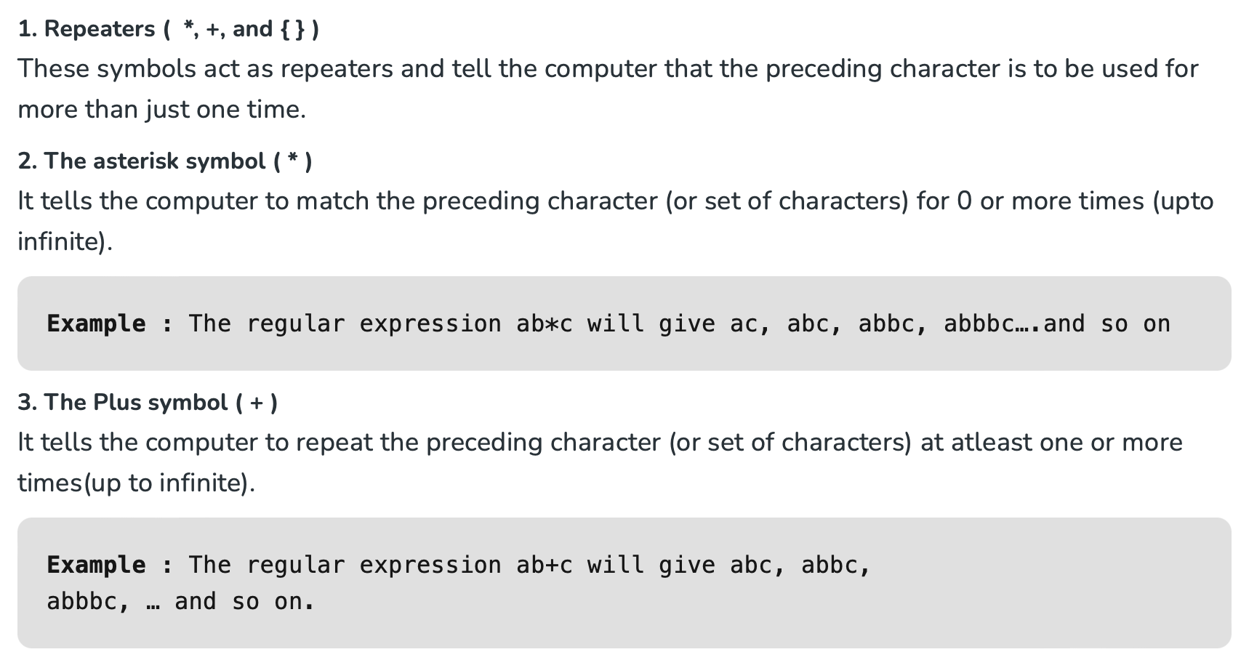
Regular Expressions

Slide 11
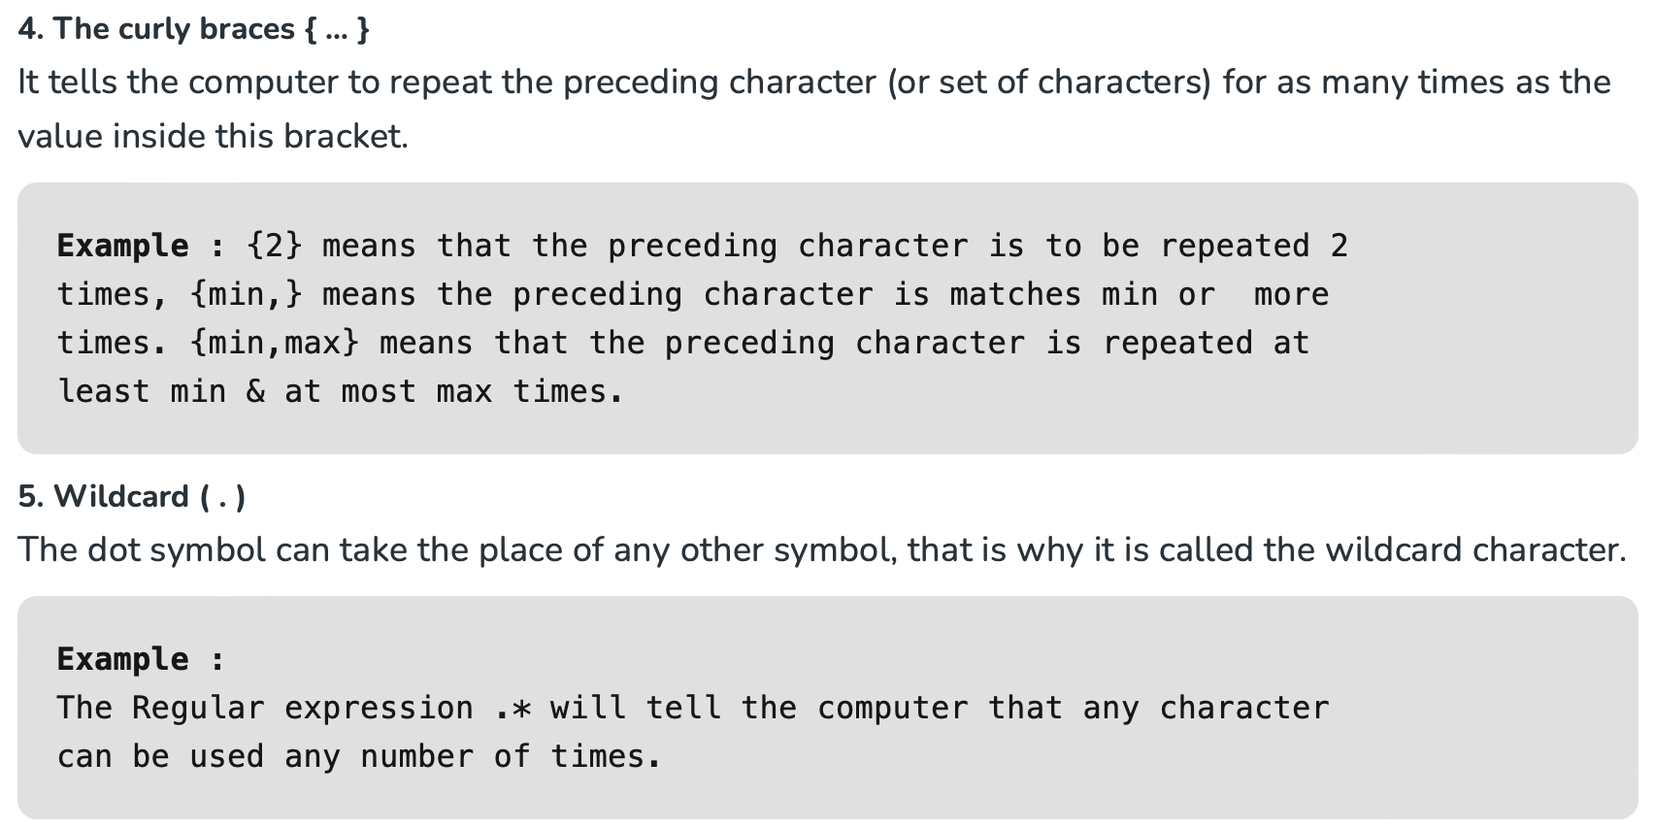
Regular Expressions

Slide 12
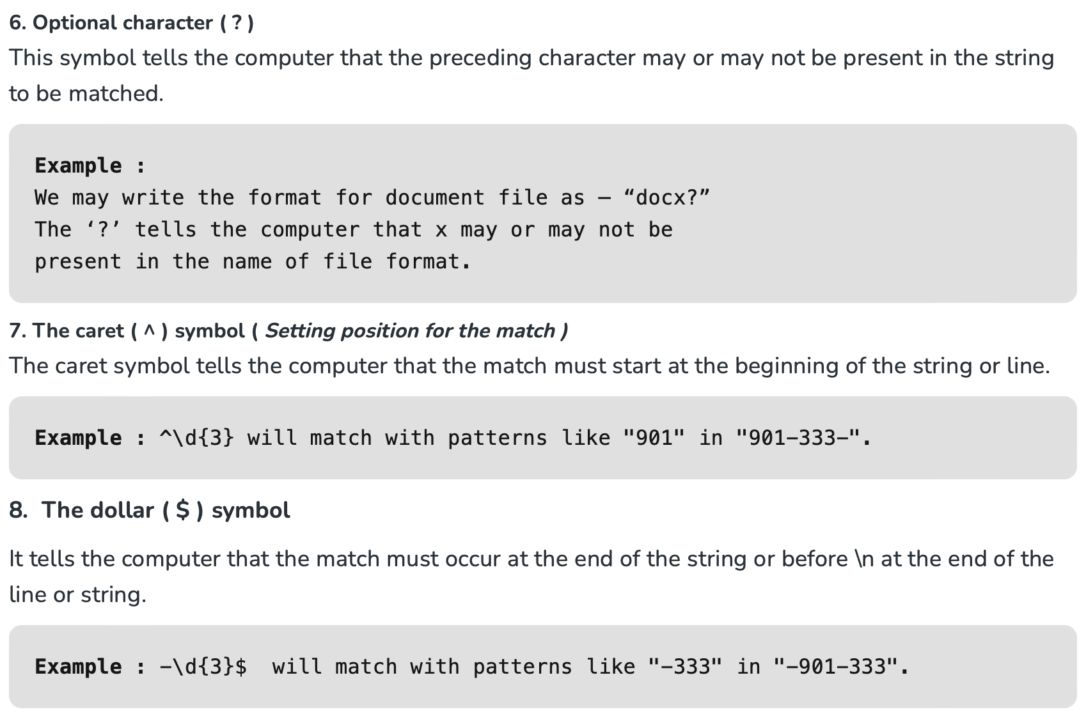
Regular Expressions

Slide 13
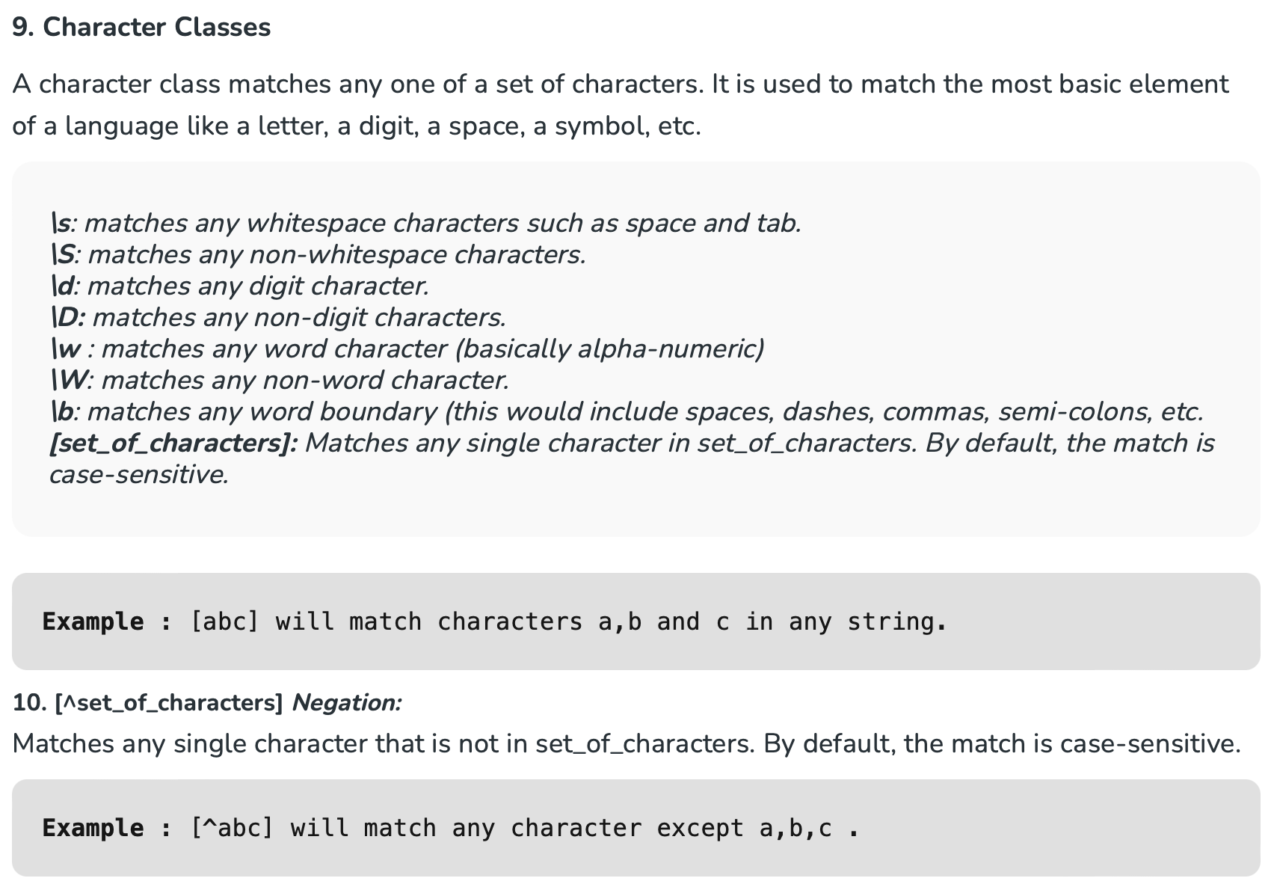
Regular Expressions

Slide 14
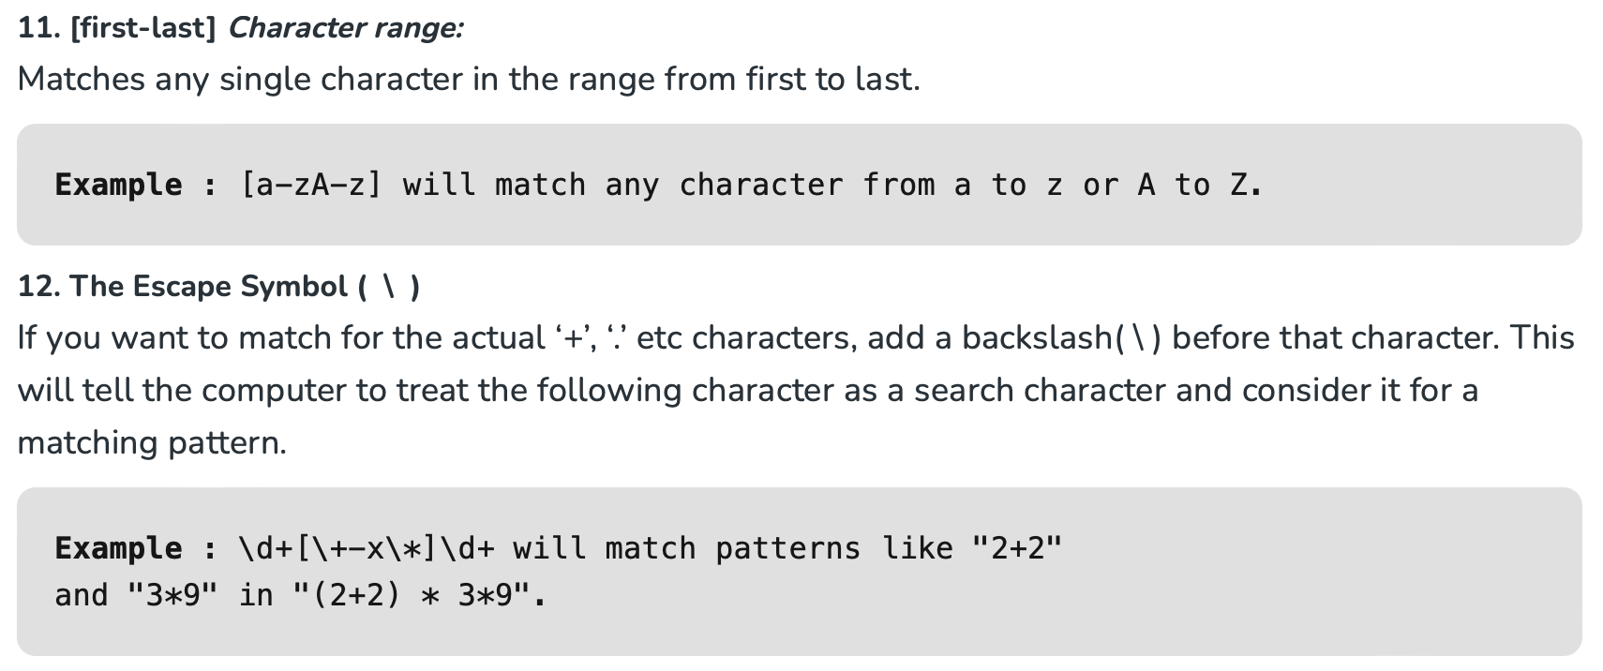
Regular Expressions

Slide 15
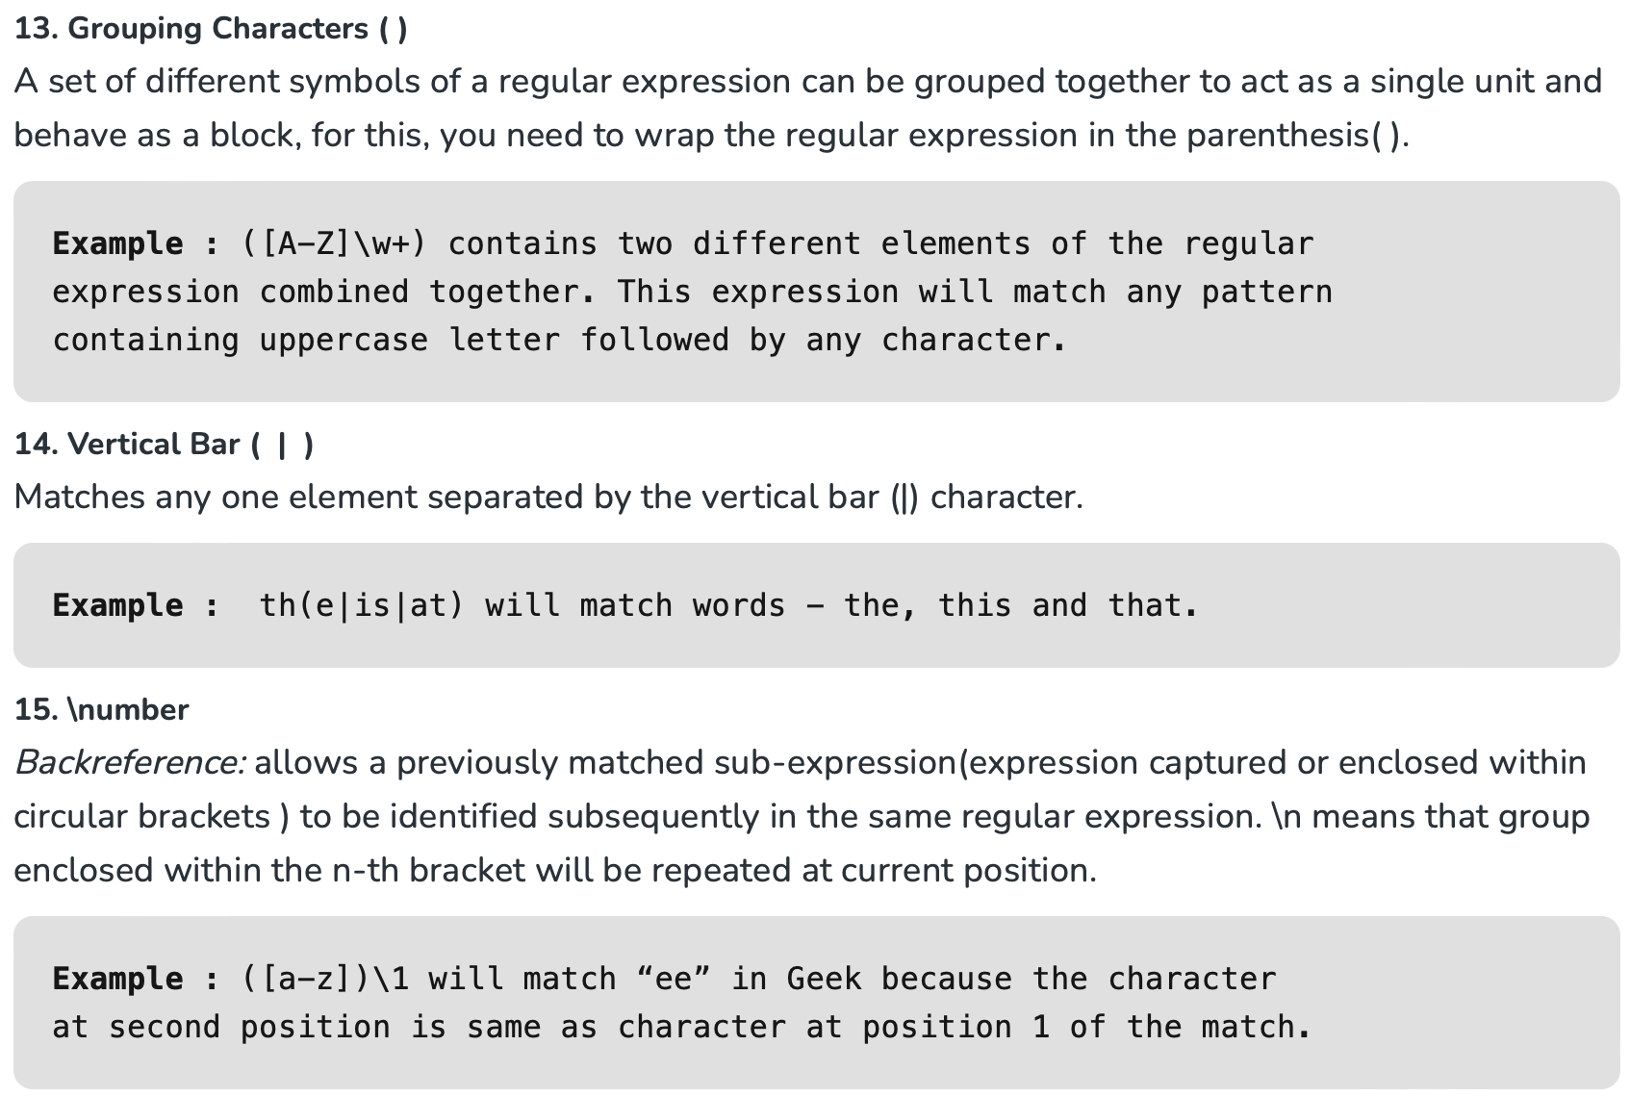
Regular Expressions

Slide 16
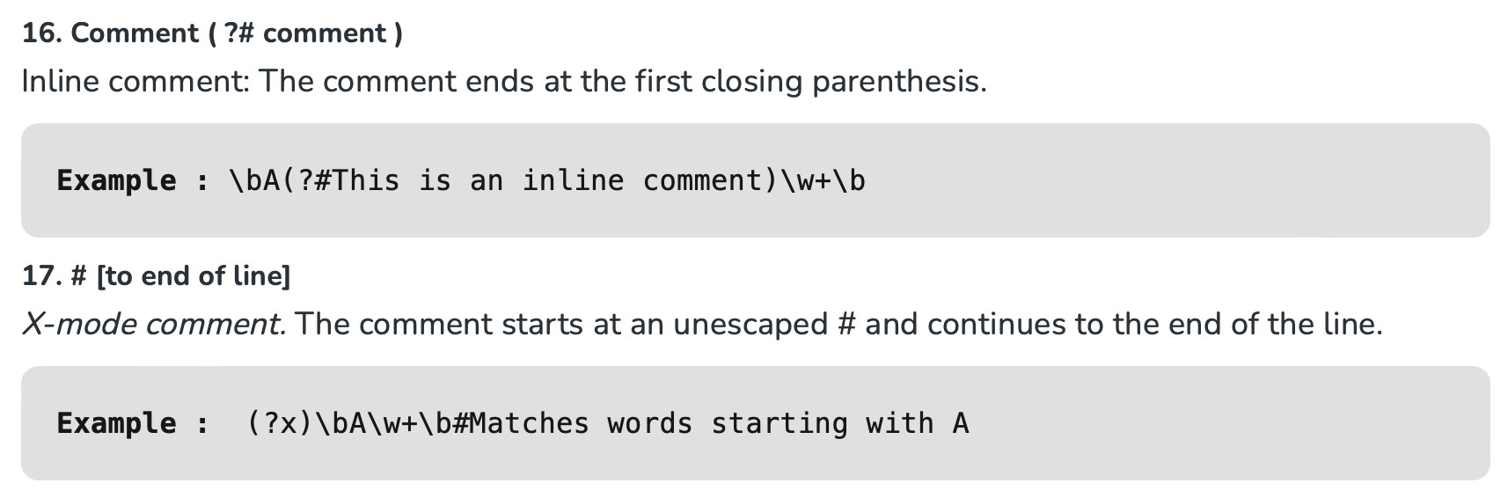
Regular Expressions

Slide 17
Exercise: Regular Expression
What the meaning of the following regular expression?
^([a-zA-Z0-9_\-\.]+)@([a-zA-Z0-9_\-\.]+)\.([a-zA-Z]{2,5})$

Slide 18
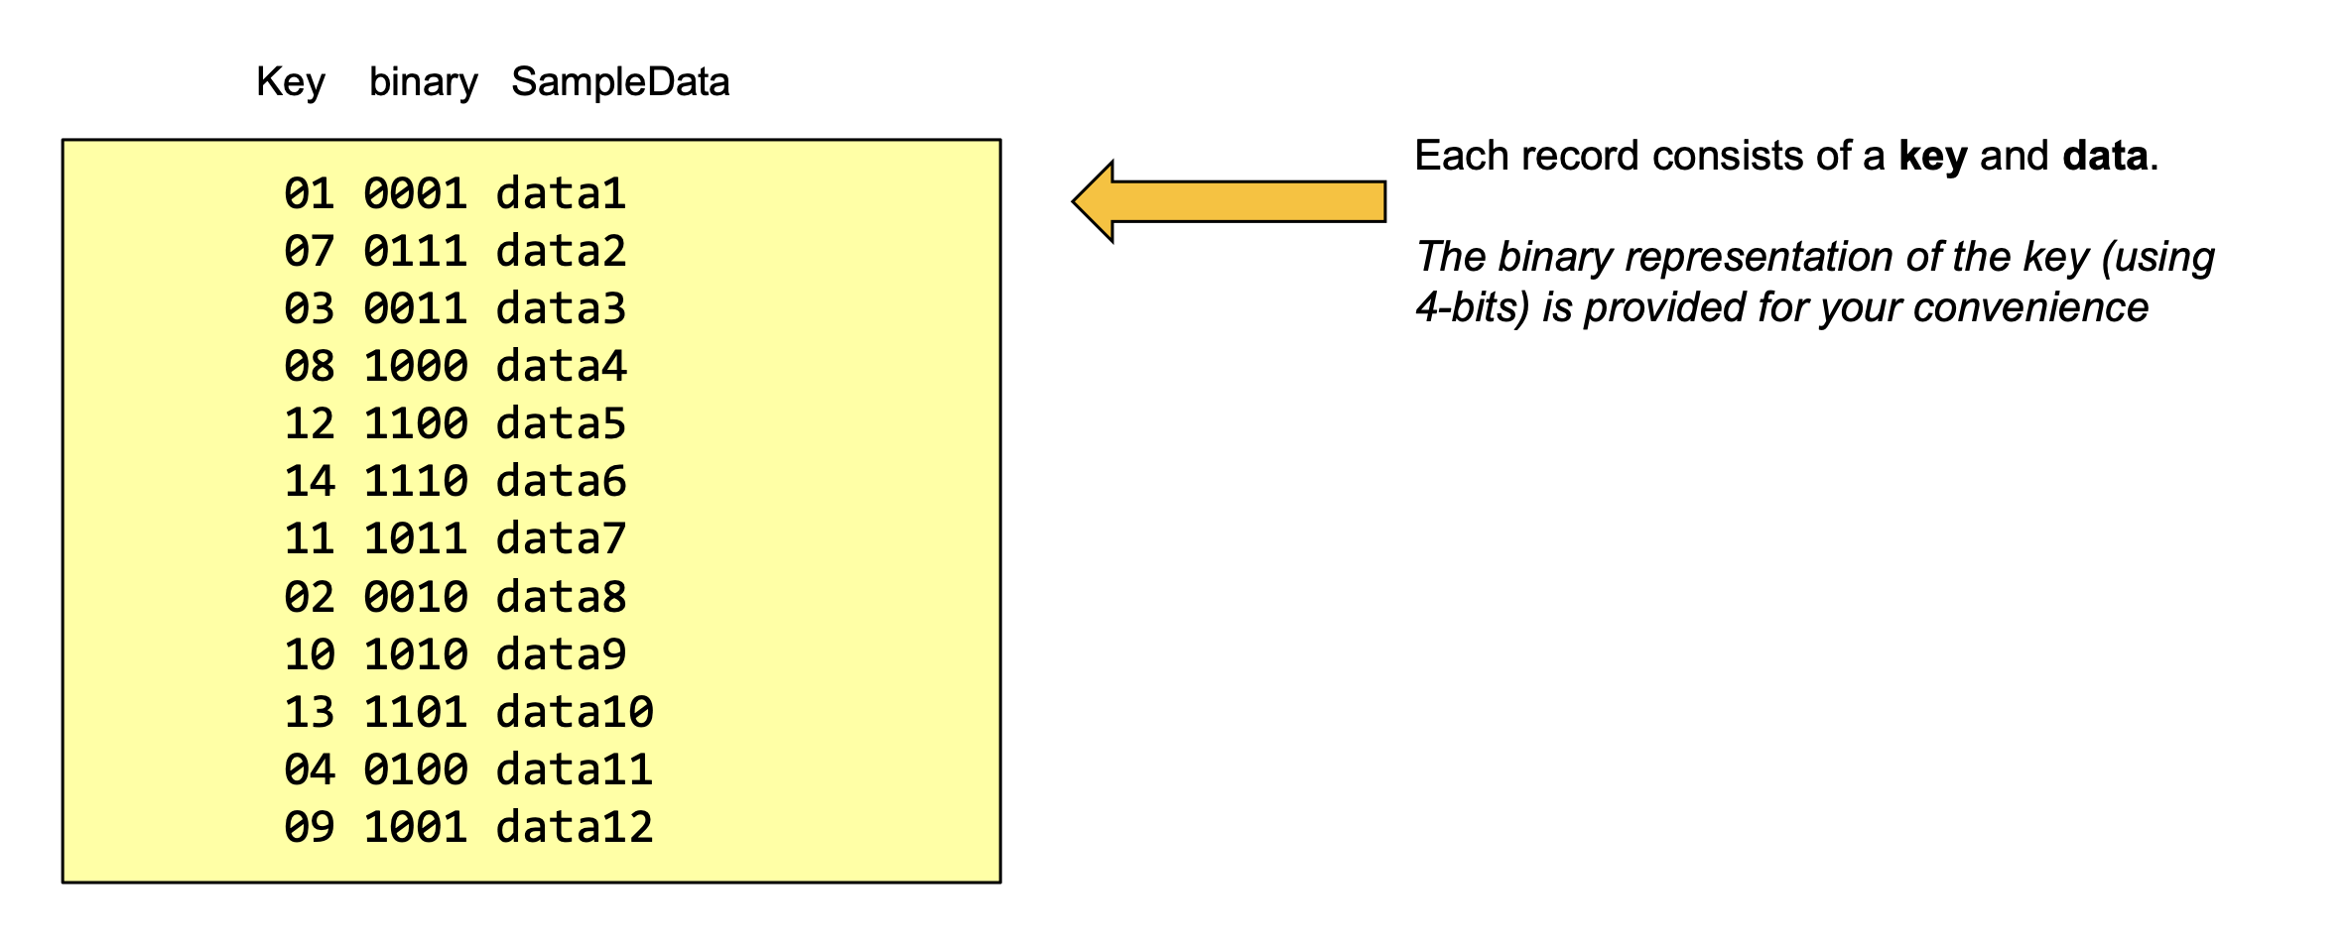
Exercise: Dynamic Hashing
Bucket size: 3
Hash Function returns first X bits.

Slide 19
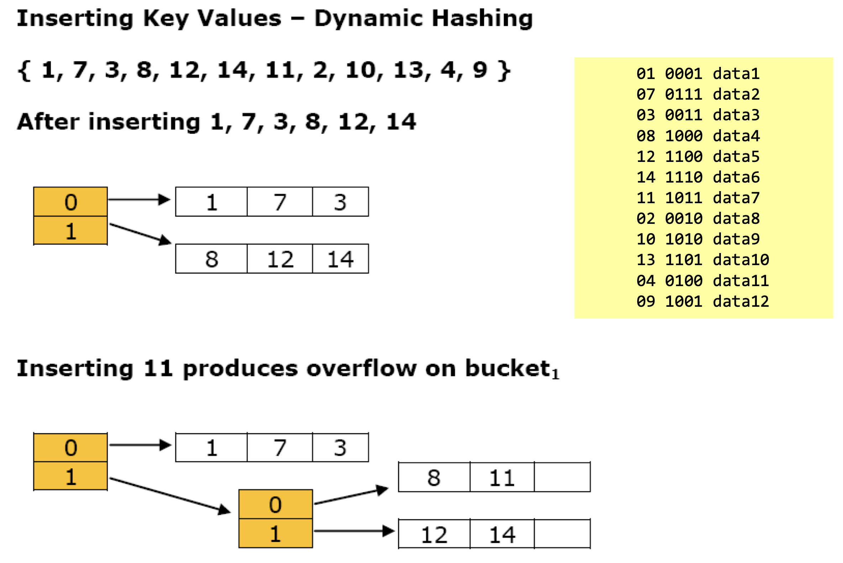

Slide 20
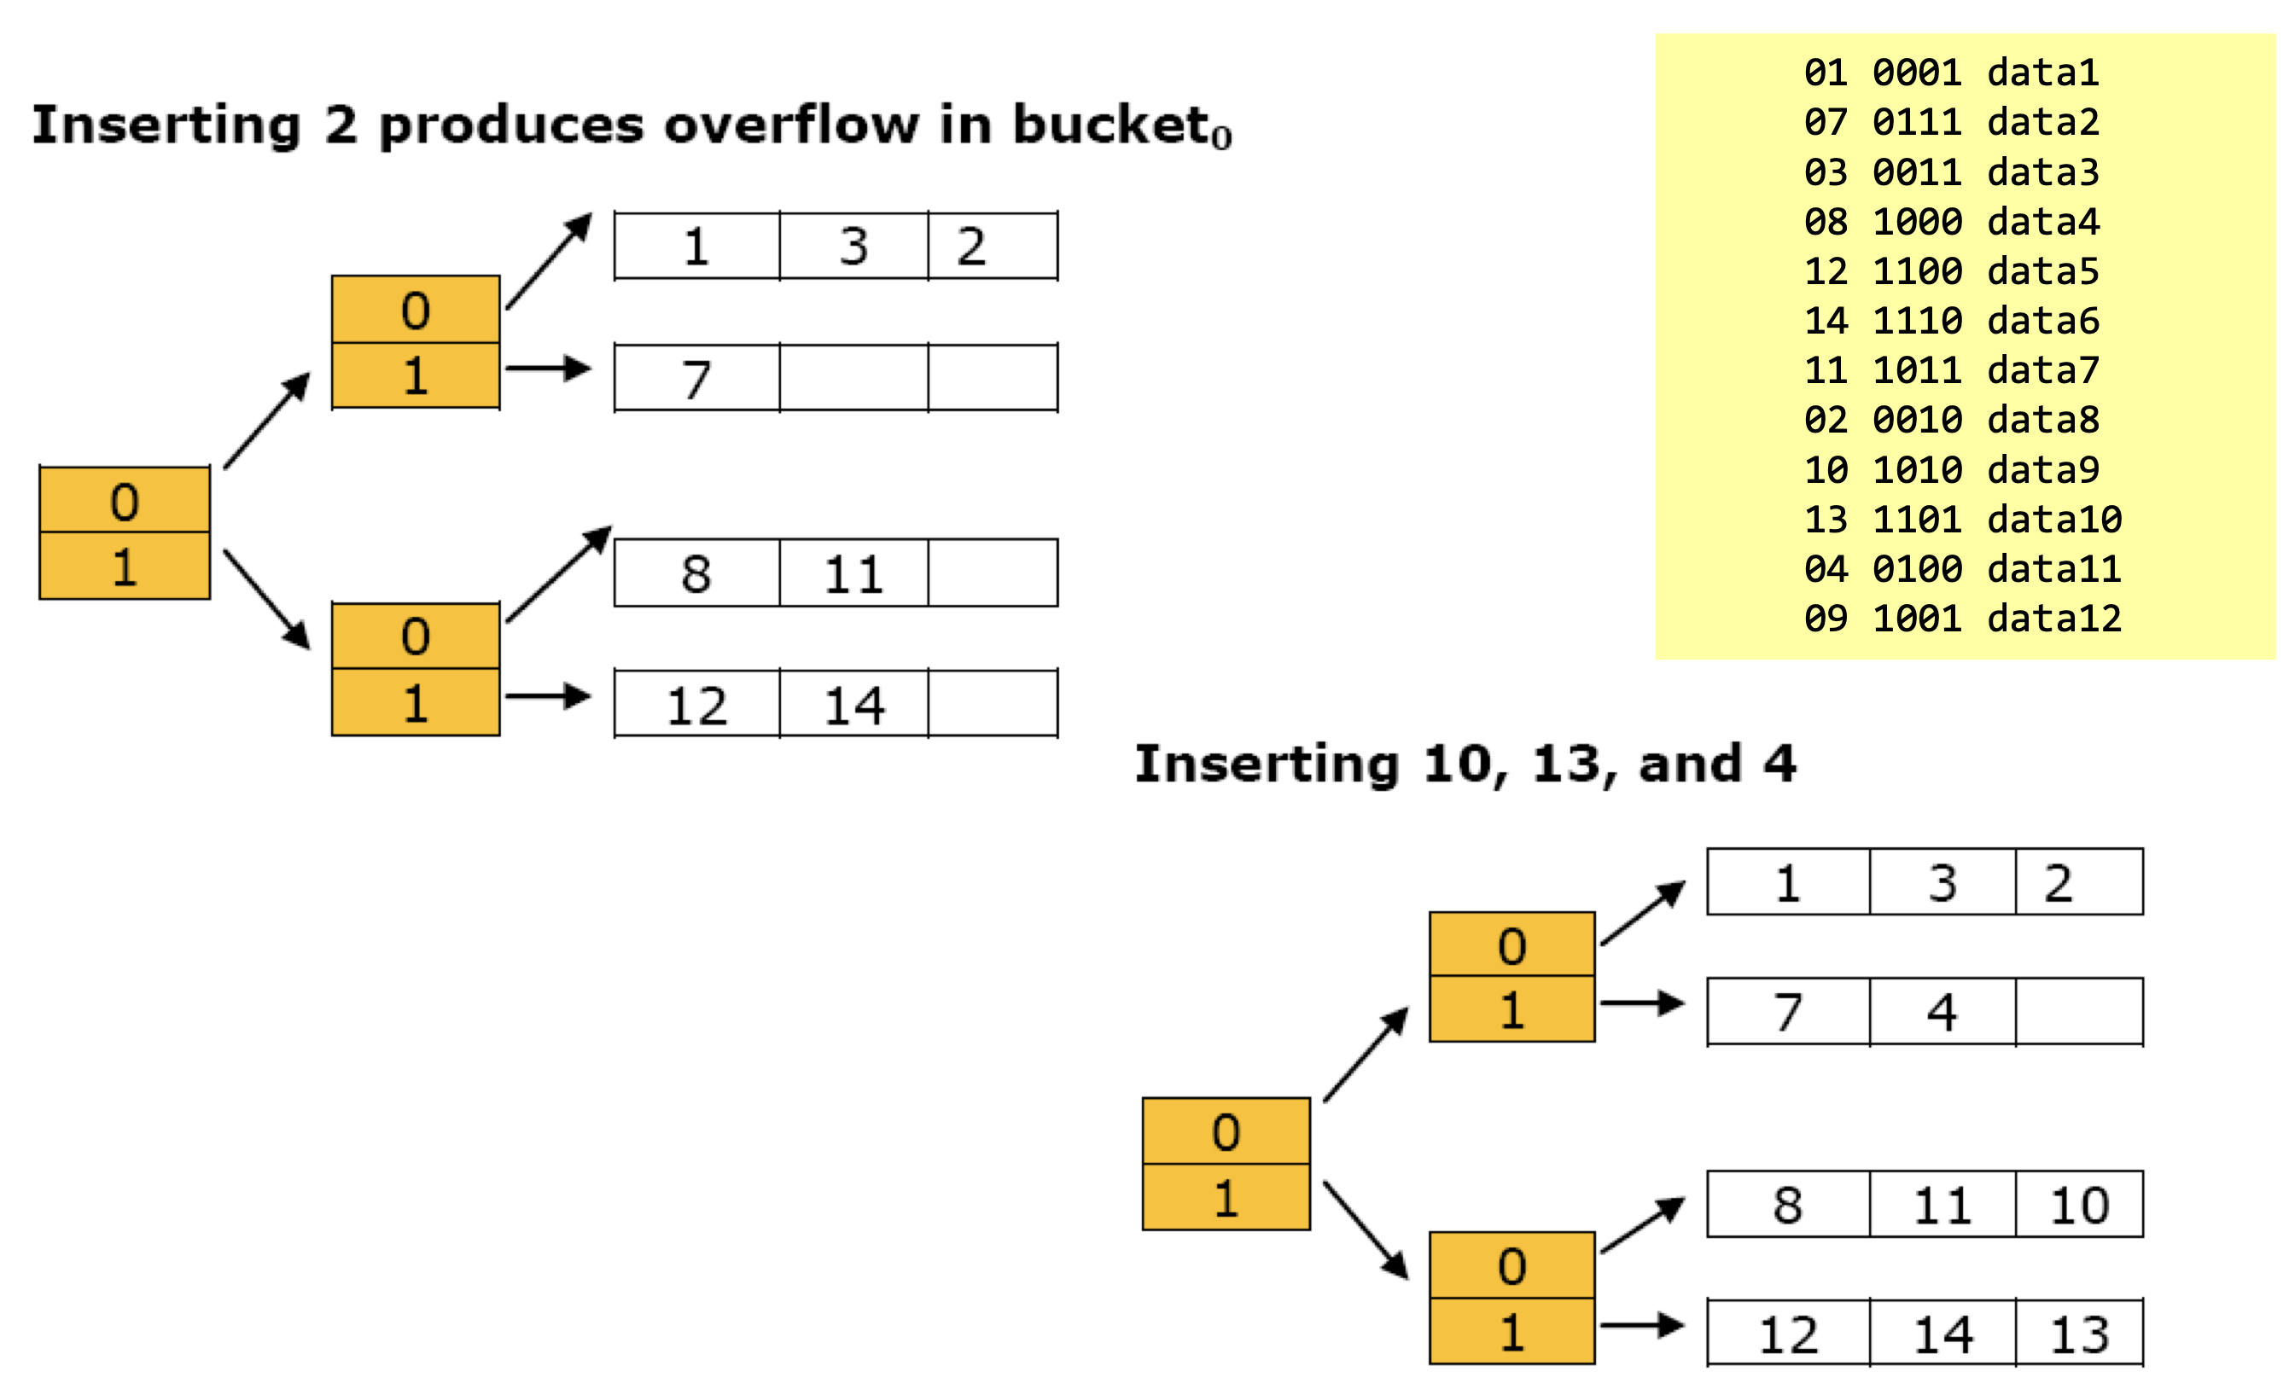

Slide 21
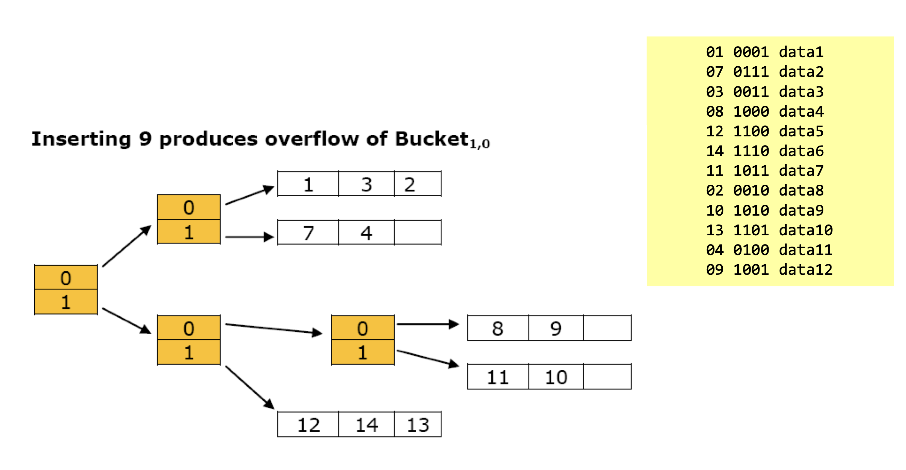
Start with 00
Start with 01
Start with 100
Start with 101
Start with 11

Slide 22
Thanks for your attention!

